Slide 1
Trivia Quiz responsive web design using html5 and Jquery

Slide 2

Trivia Quiz Application
Fadhilah Jasman
Kevin Fabian Mahardika

Slide 3
Analysis

Slide 4
Implemented in software systems intended to address quiz so that achieve a desired expectation is :
Improve brain quickly and efficiently
Increase the insight and knowledge
In Trivia Quiz responsive web design there are HTML5,JavaScript,JQuery,and Bootstrap.

Slide 5
HTML Pages

Slide 6
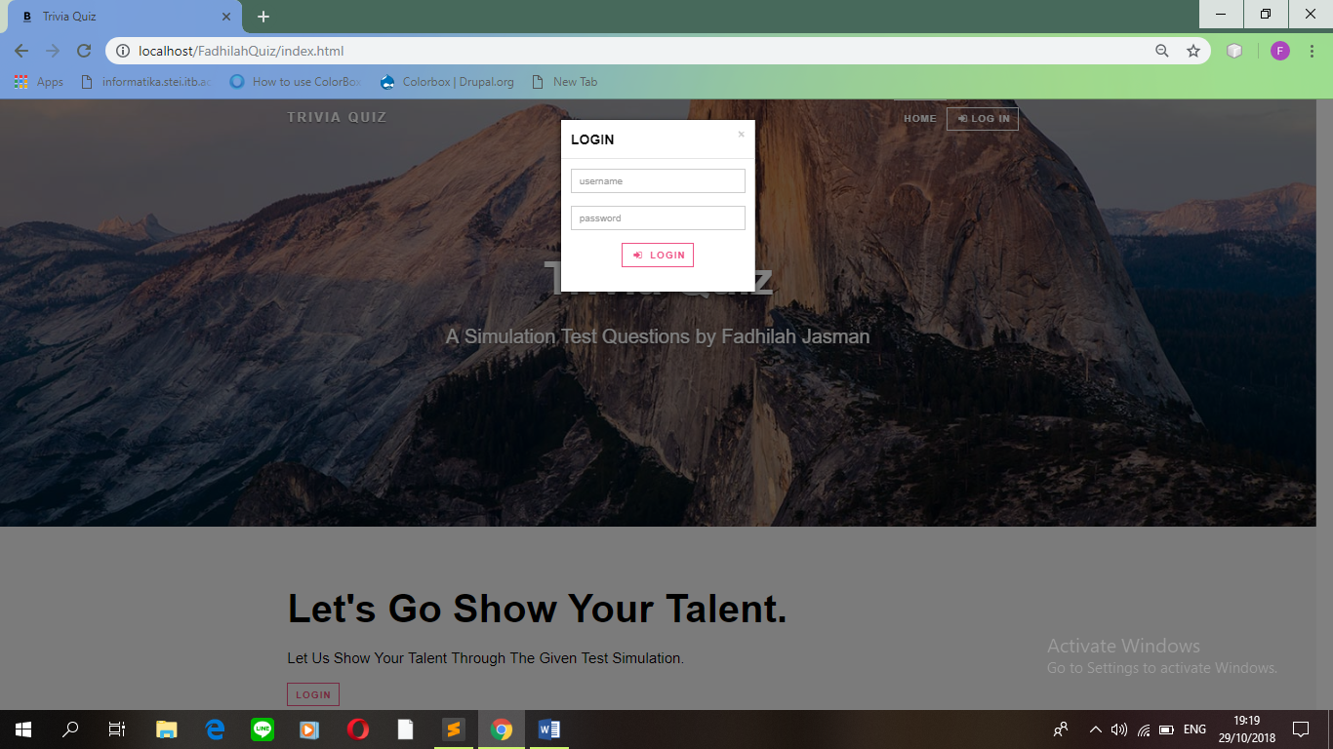

Slide 7
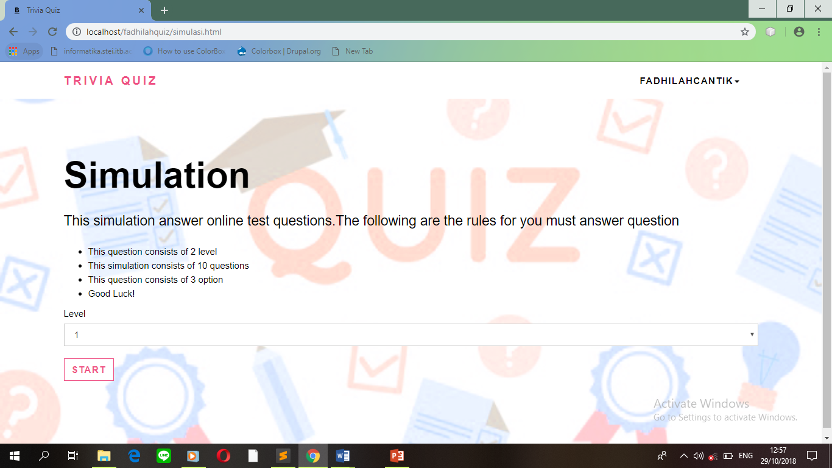

Slide 8
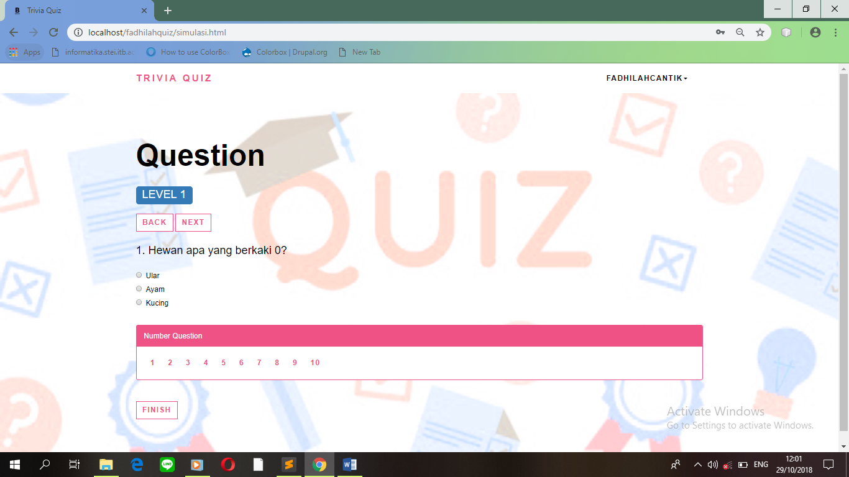

Slide 9
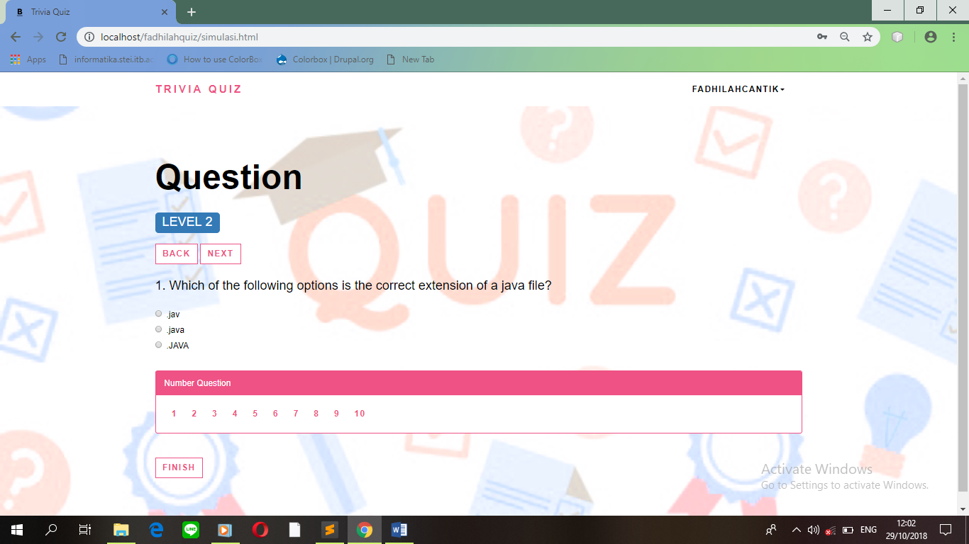

Slide 10
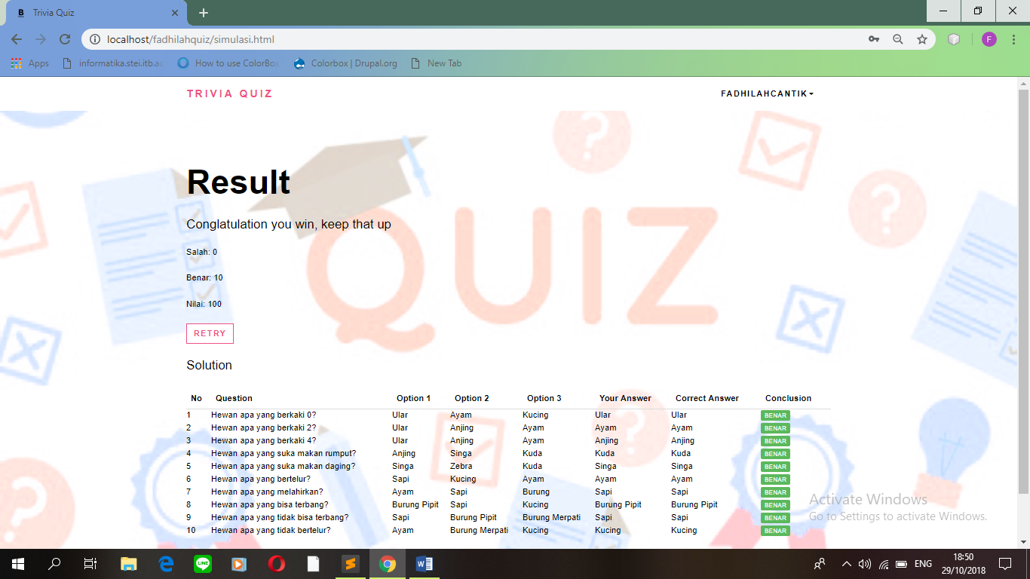

Slide 11
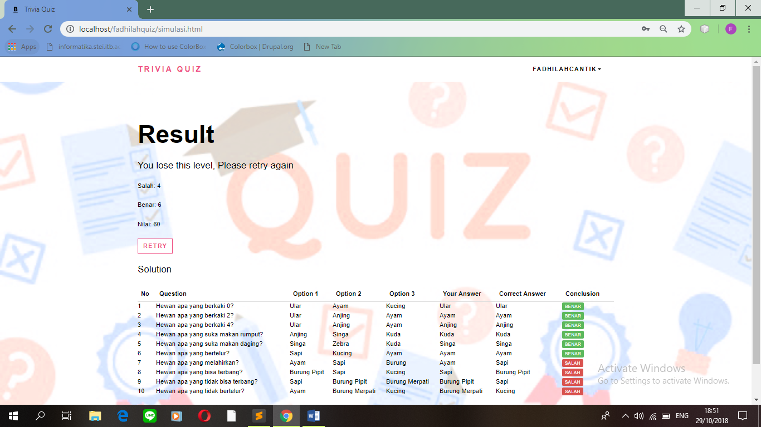

Slide 14
RWD,HTML5,JQuery,JavaScript & Bootstrap

Slide 15
Responsive Web Design(RWD) a new web design technique,helps designers to create device-independent web content and negletct device-specific elements,such as physical attributes,browsers,client-side rendering,and operating systems.
HTML5 it is a versatile markup language that can be used on different web browsers to publish information as a web page.

Slide 16
JQuery can be used to manipulate HTML elements and apply complex effects on them.
JavaScript is a scripting language that is used to create client-side scripts.

Slide 17
Bootstrap simply find the exact piece of code and fit it into their website,include HTML and CSS based design templates and JavaScript plug-ins to create the ui components.

Slide 18
Any Question ?
😉

